Slide 1
SPCD fMRI Results
Lab Meeting
Qingfang Liu
June 18, 2026

Slide 2
Behavioral results suggest that preconditioned cues carry reward-identity information. Here, we ask:
Where is such reward identity represented in the brain?
Does it overlap with conditioned-cue reward identity representations?
We focus especially on lateral OFC, given prior evidence that (1) it represents odor identity for directly learned conditioned cues and (2) supports inferential behavior.

Slide 3
Neural RDM ~ odor identity RDM + button RDMs.
Image-wise beta estimates were derived from the probe task using LSS.
Neural RDMs were regressed onto odor-identity and button-response model RDMs.
Conditioned and preconditioned cues were analyzed separately.
Pre-meal only, odor-predictive cues only (excluding clean-air cues)

Slide 4
Conditioned and preconditioned cues showed partially distinct spatial patterns of reward-identity encoding.
Red: preconditioned cues.
Blue: conditioned cues.
Notes:
2-2.5
Without having image identity RDM regressor, using 1st image per trial only
This seems to suggest that with both conditioned and preconditioned cues, lateral OFC is representing odor identity of preconditioned cues, rather than conditioned cues

Slide 5
ROI-based analysis of reward-identity representation
Notes:
Left 47m
Thresholded at 30

Slide 6
Visual-control RSA
Neural RDM ~ odor identity RDM + visual image RDM + button RDMs.
Visual image RDMs were estimated using either a fixed visual-cortex mask or searchlight-local localizer patterns.

Slide 7
Broad RSA model
Neural RDM ~ odor identity RDM + cue type RDM + image identity RDM + button RDMs.

Slide 8
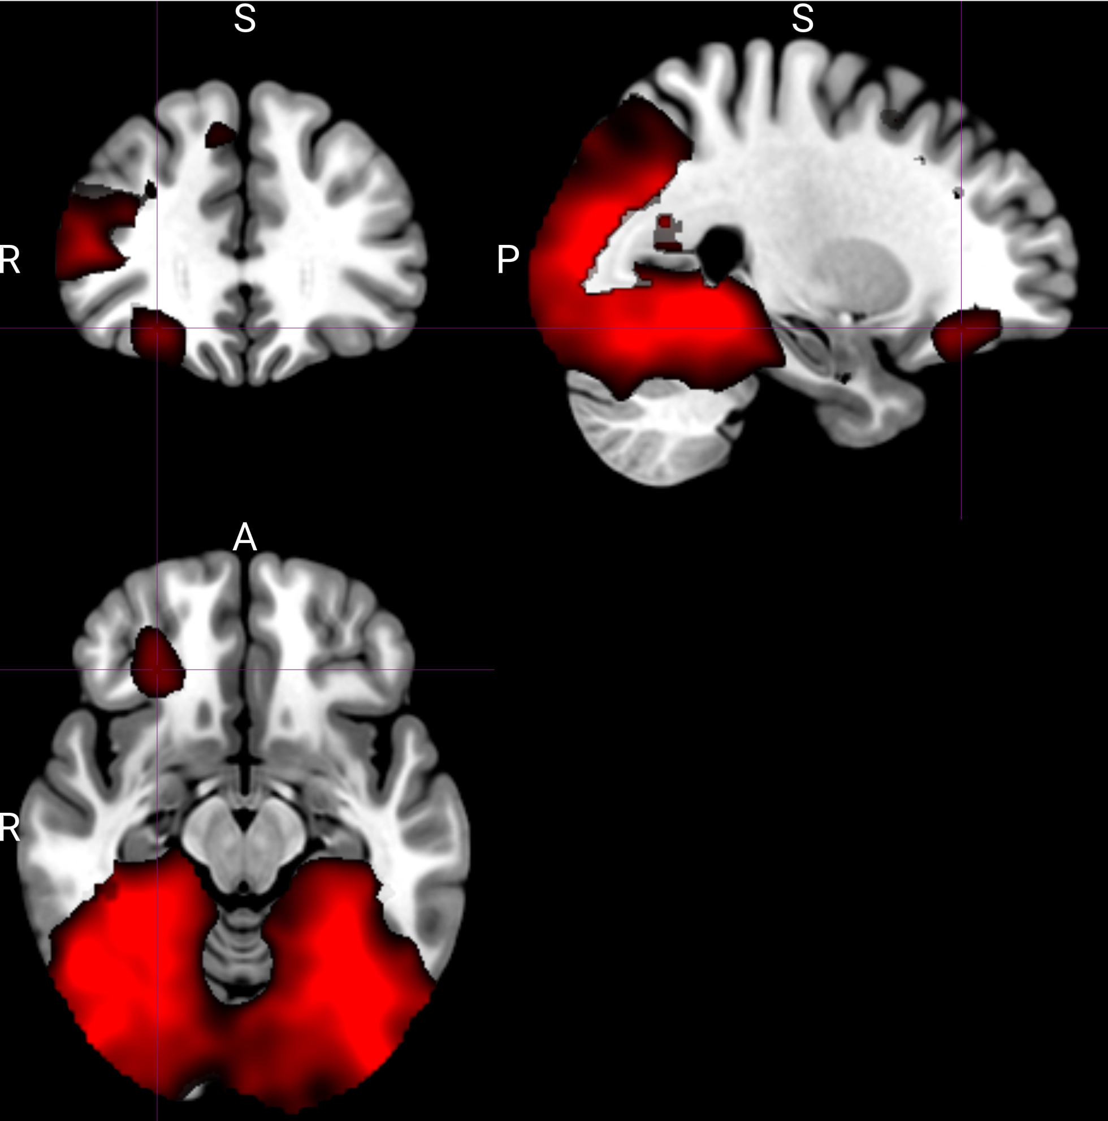
Cue-type RSA identified regions distinguishing conditioned from preconditioned cues.
Data were combined across pre-meal and post-meal sessions.
Notes:
Thresholded at >3

Slide 9
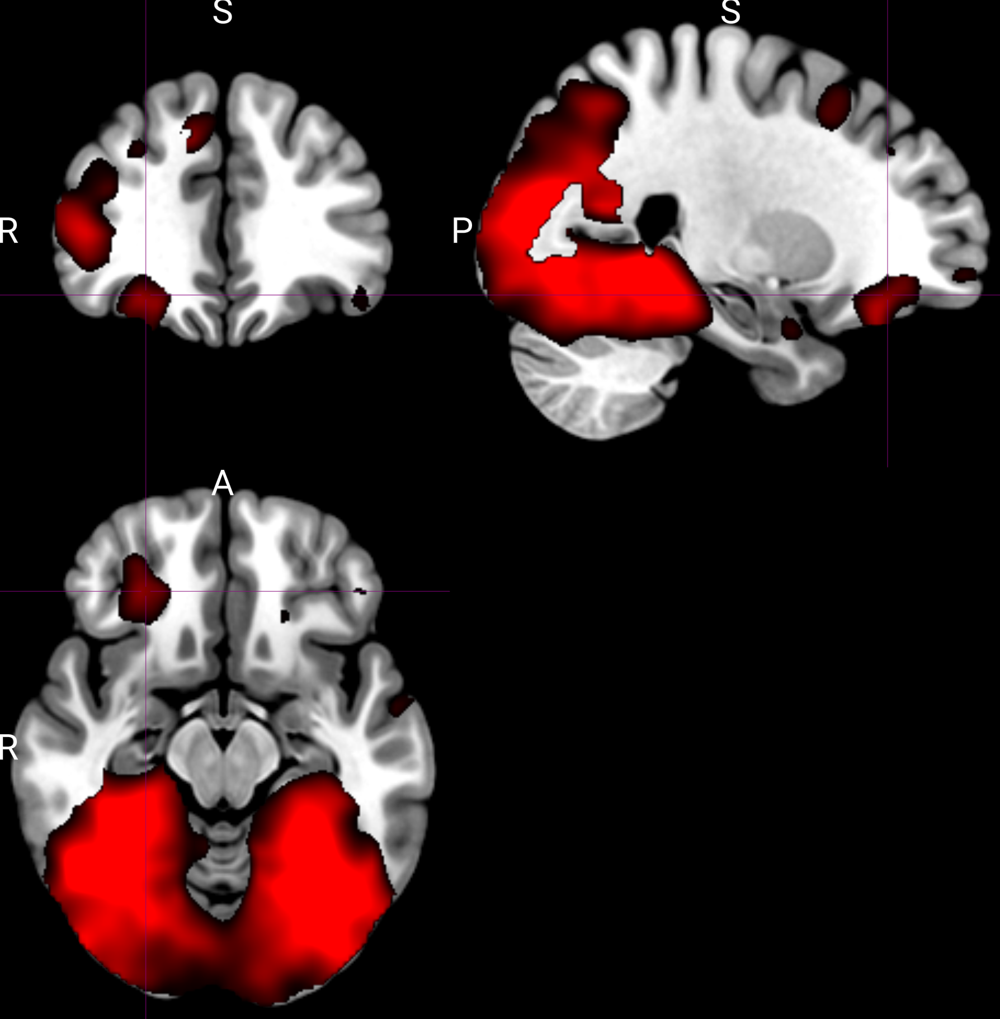
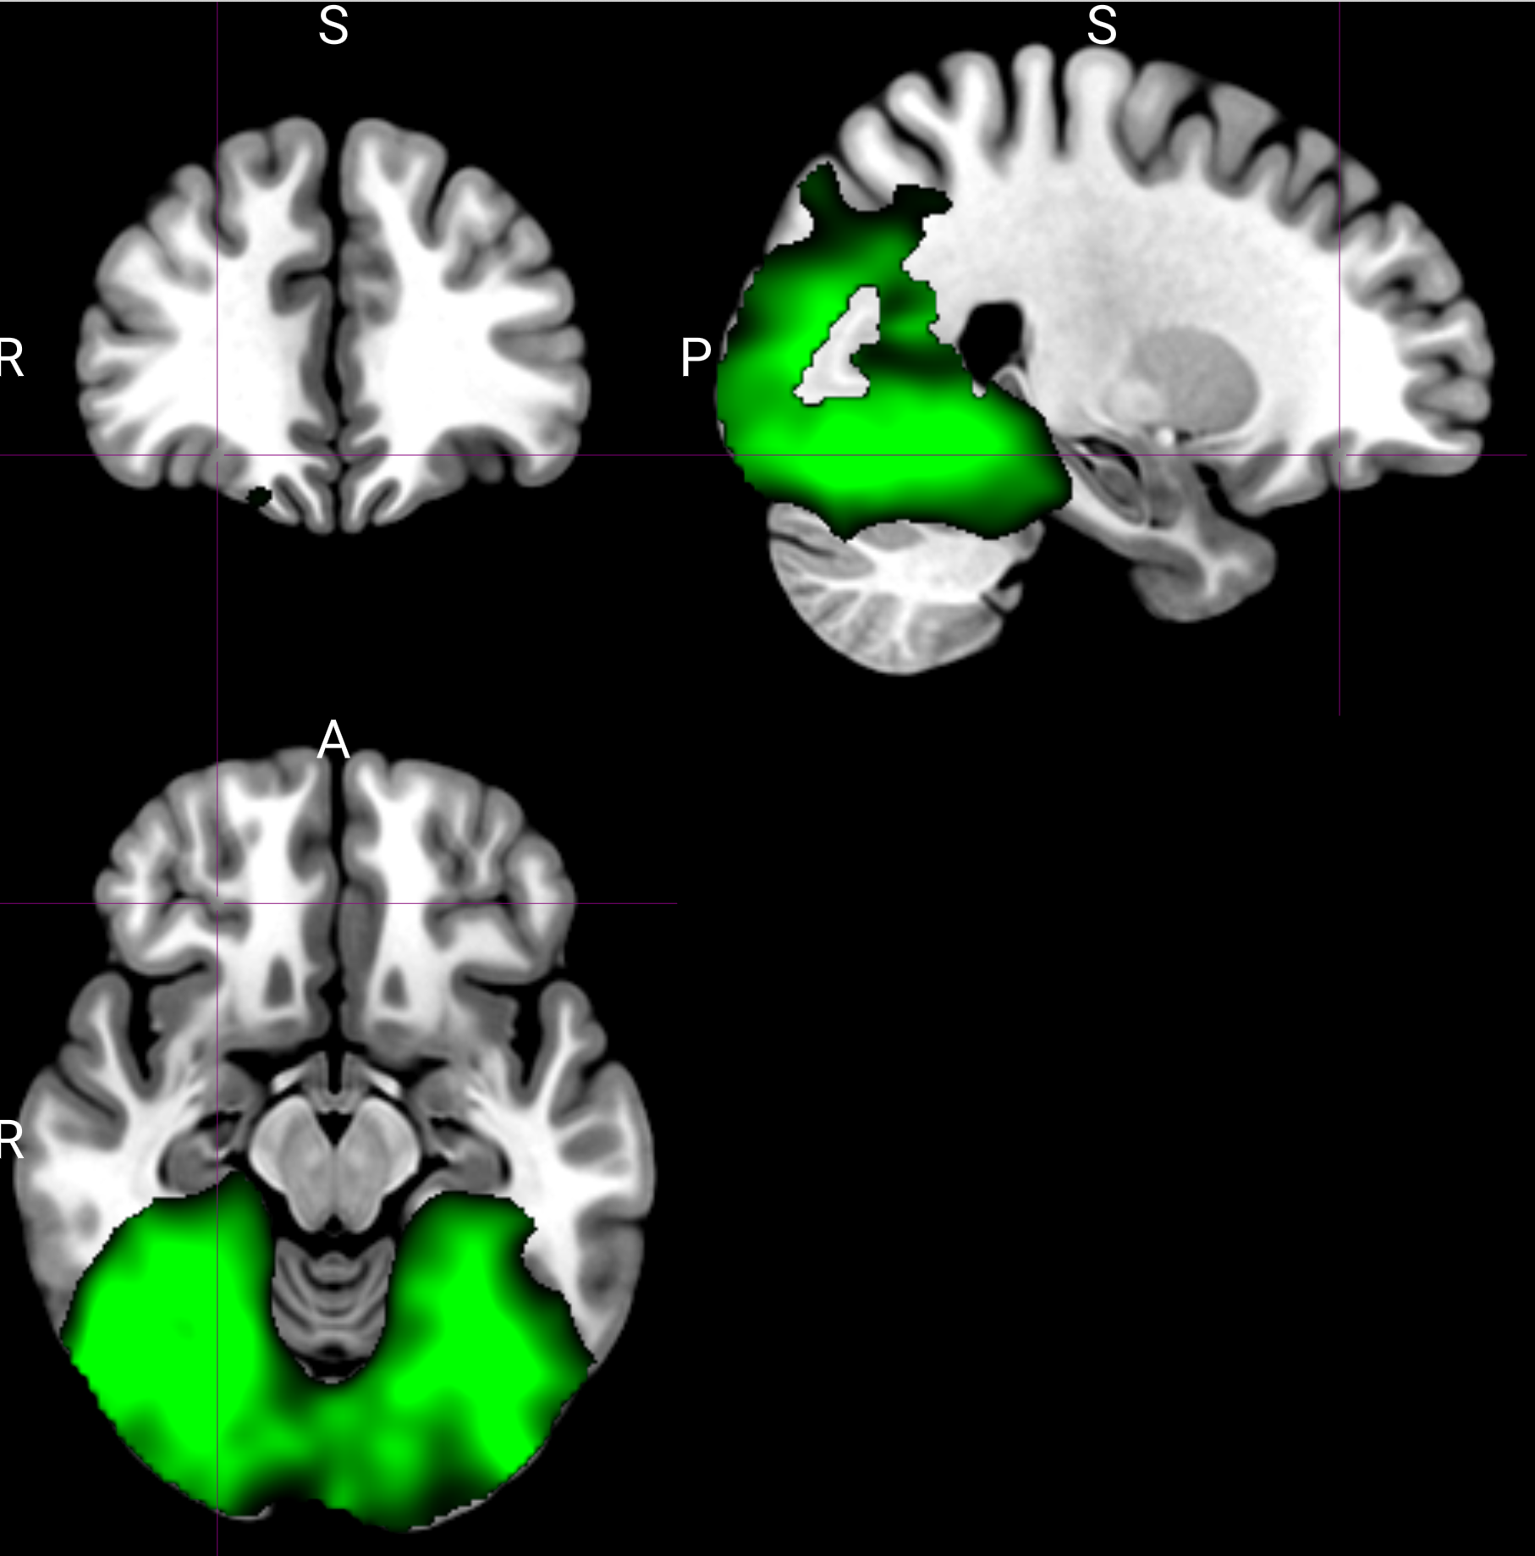
Cue-type representations were compared across meals.
Red: pre-meal. Green: post-meal.
Display threshold: t > 3; peak [26, 36, -14].

Slide 10
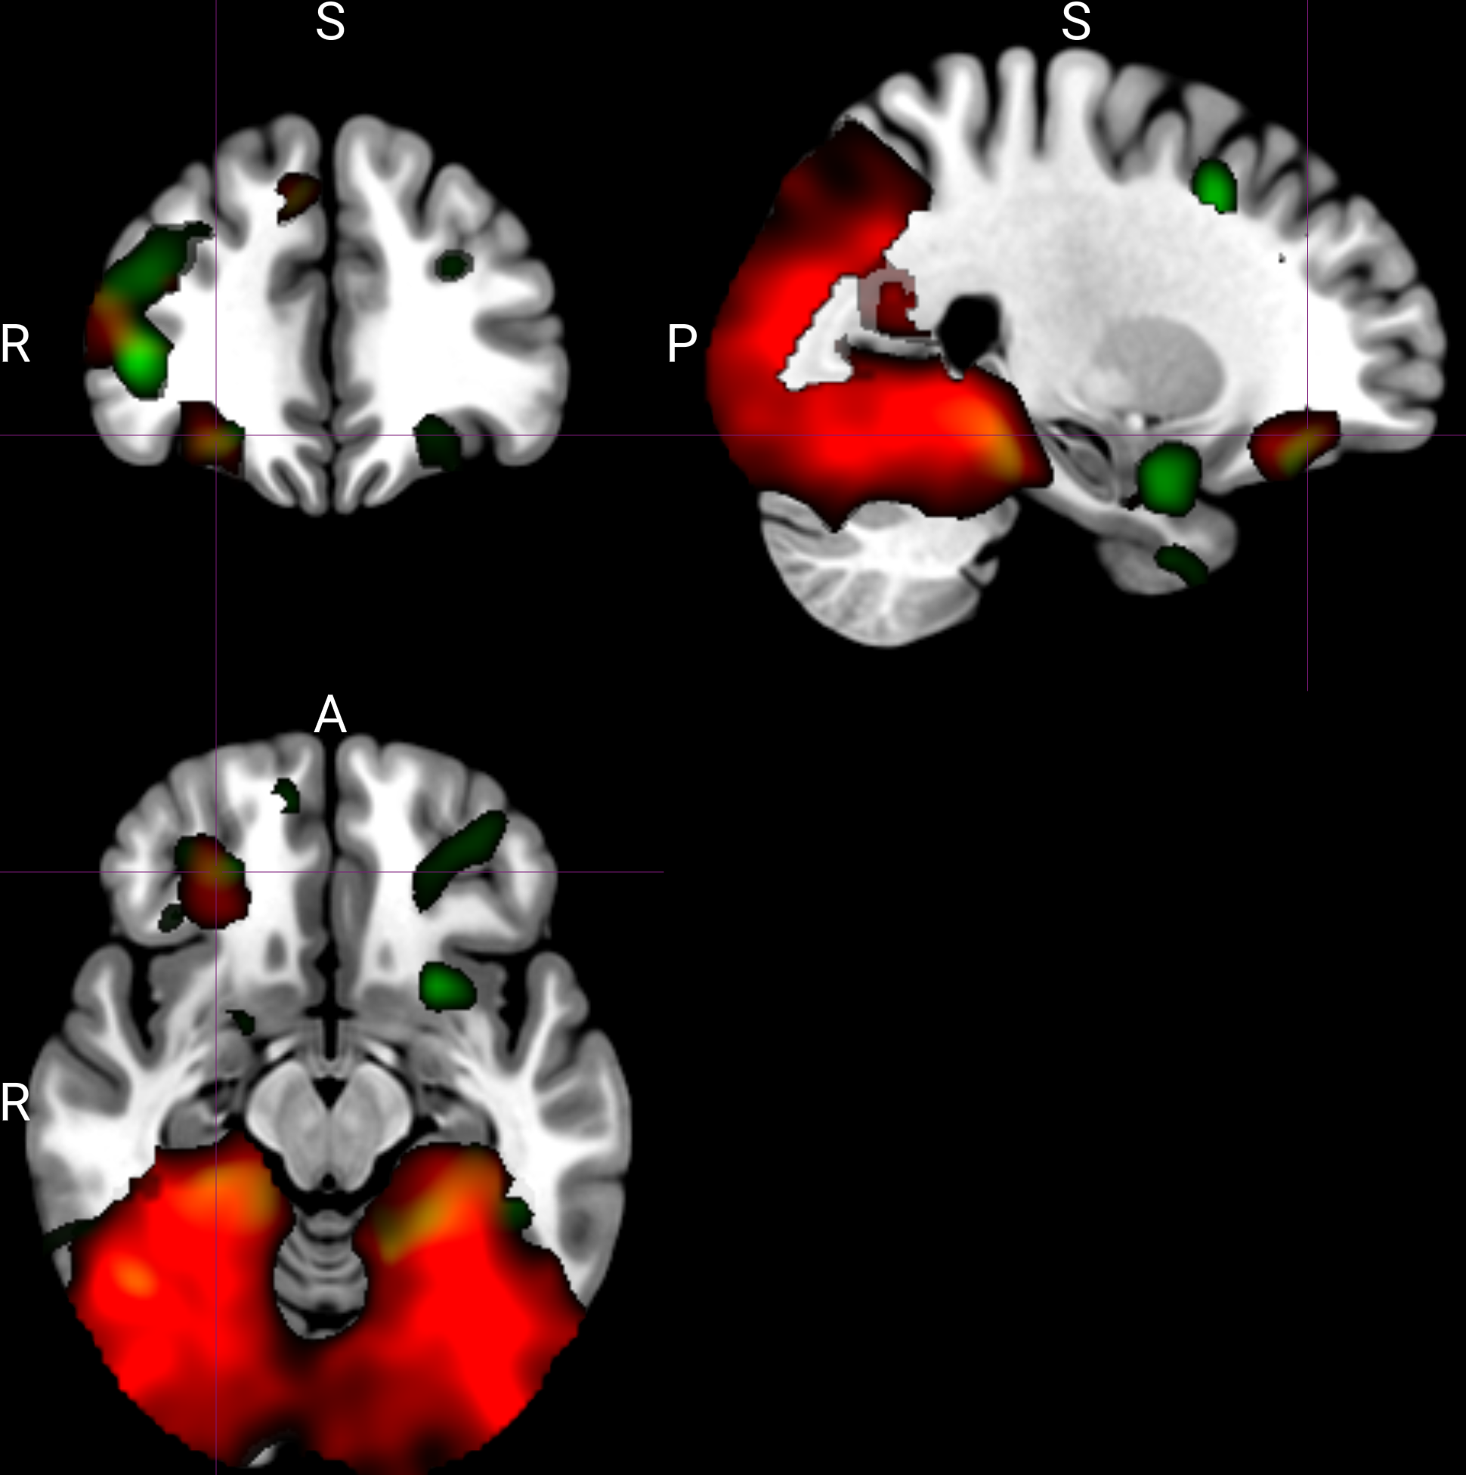
Cue-type representations decreased from pre- to post-meal.
Green: pre-to-post decrease, thresholded at t > 2 and overlaid on the cue-type map in red.

Slide 11
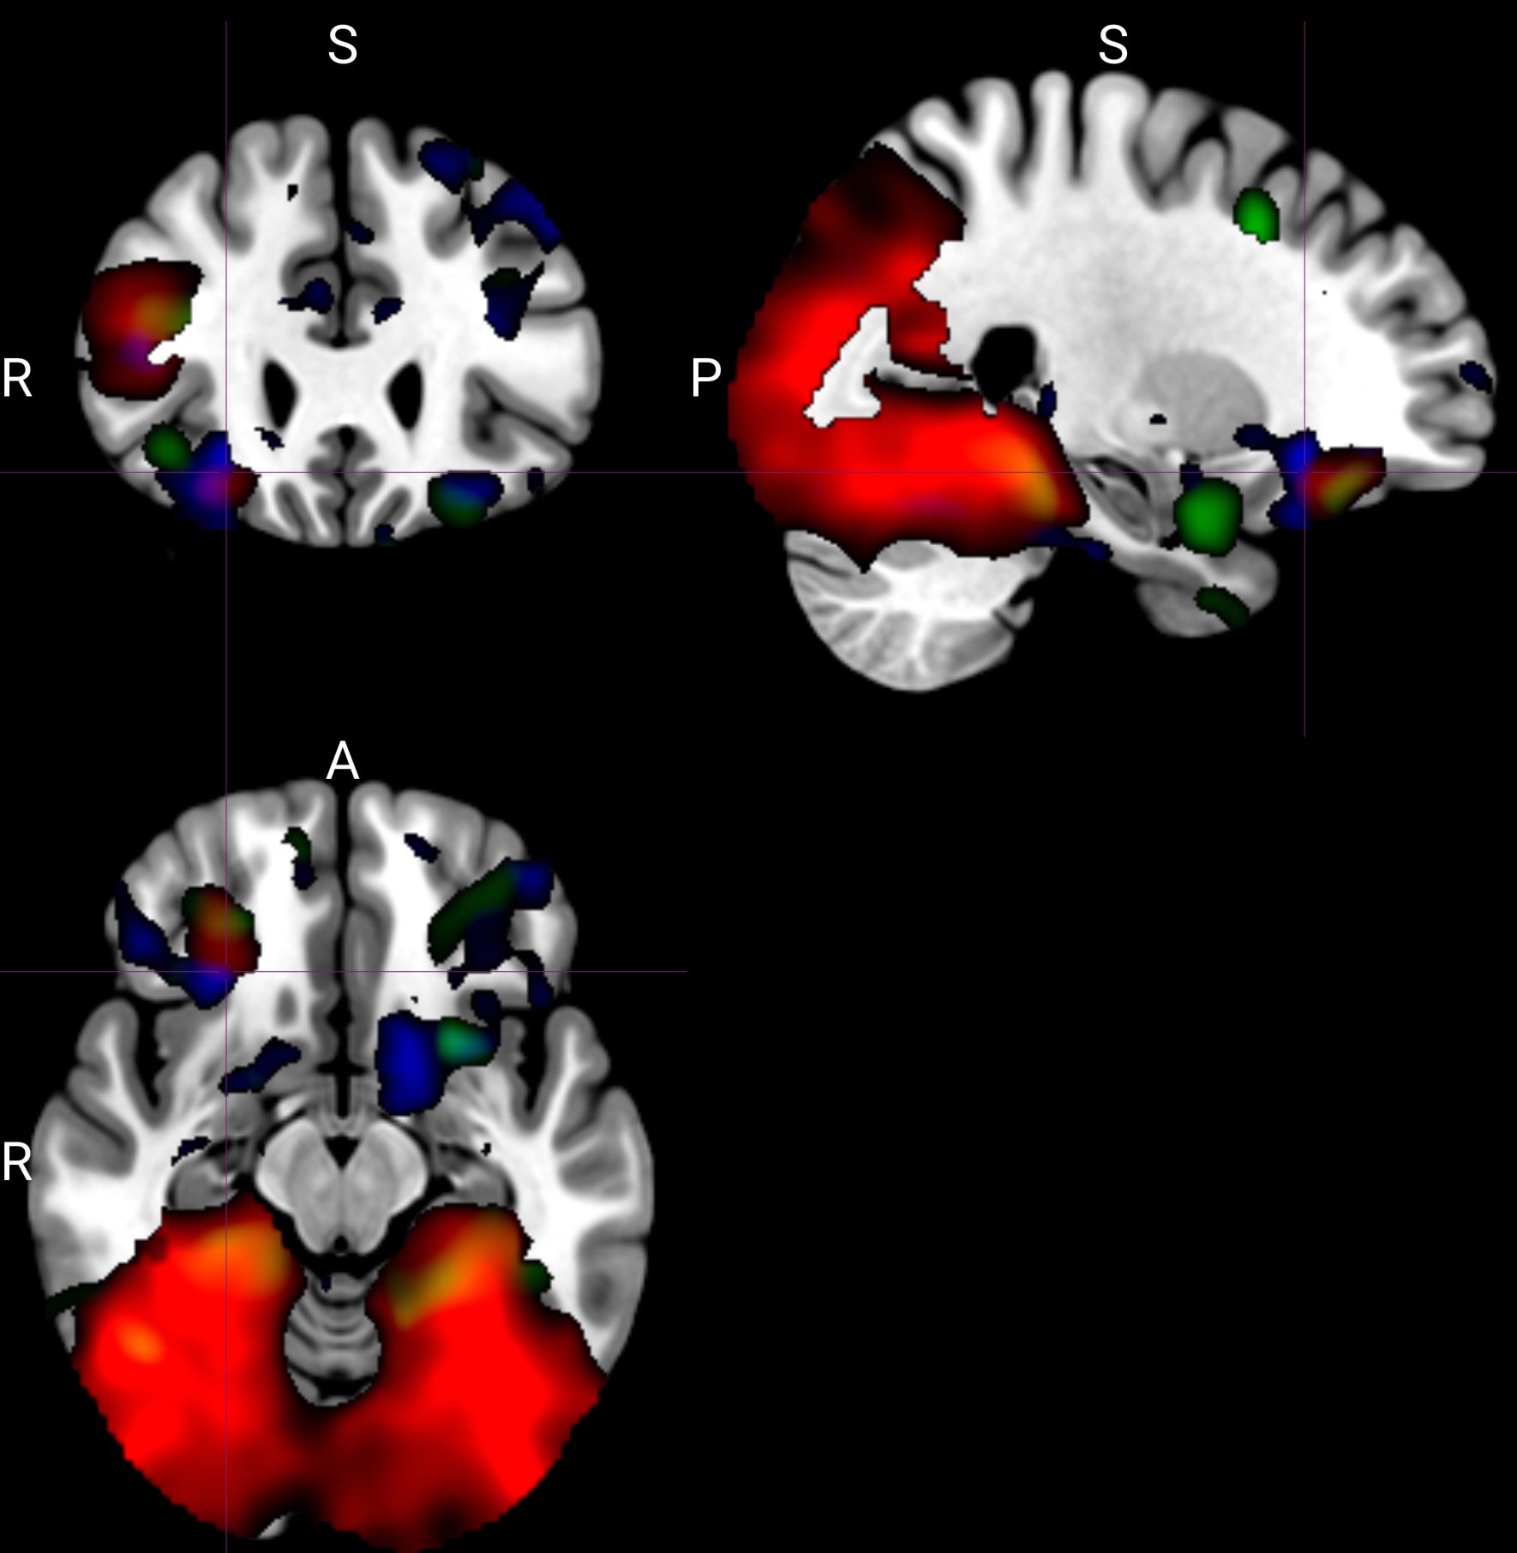
Univariate responses were stronger for preconditioned than conditioned cues in several regions.
Blue clusters: t > 2.

Slide 12
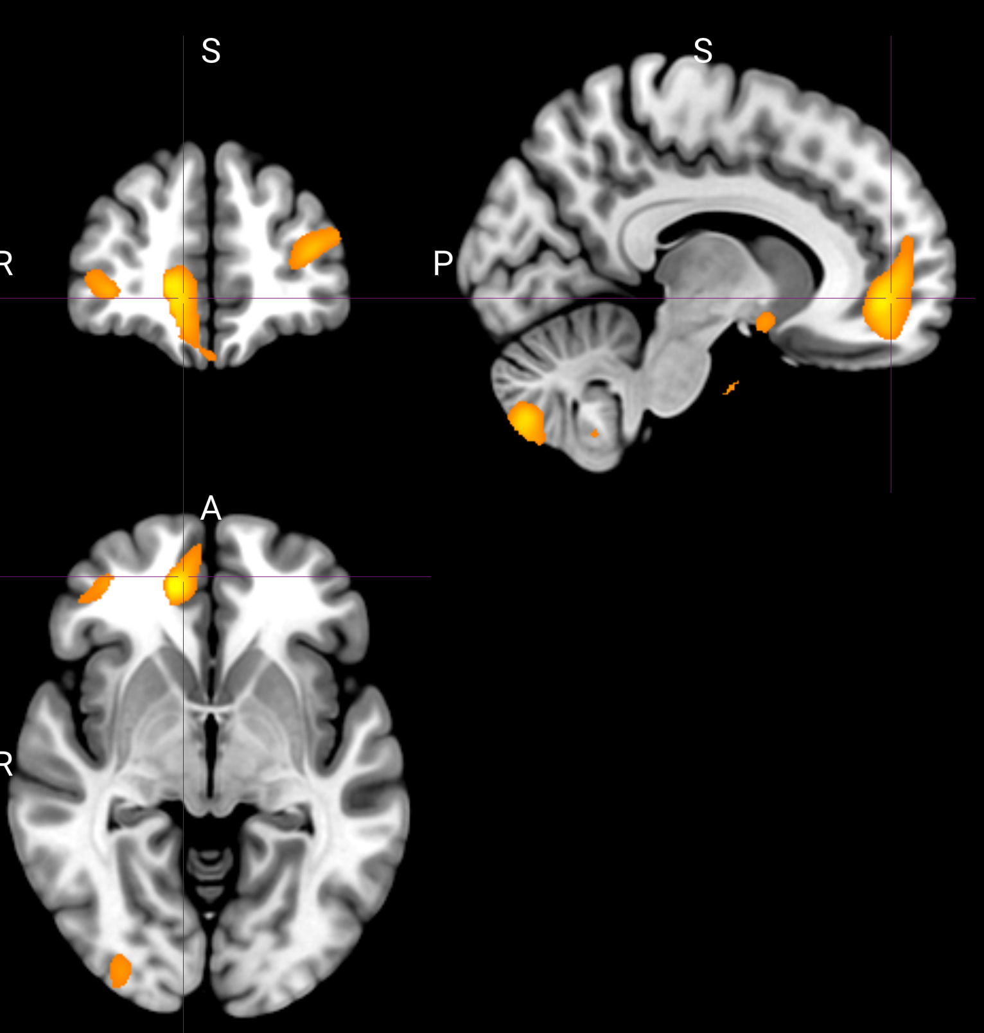
Value representation
Odor pleasantness ratings were used as a proxy for value.
Data were combined across pre- and post-meal sessions.

Slide 13
Thank you.

